Slide 1

Integrating Multi-Dimensional, Multi-Source Knowledge for Social Media Data Mining
Jingjing Wang
Final Exam
Department of Computer Science
University of Illinois at Urbana-Champaign
May 6, 2016
Committee Members
Prof. Jiawei Han (Chair, UIUC)
Prof. Chengxiang Zhai (UIUC)
Prof. Julia Hockenmaier (UIUC)
Prof. Qiaozhu Mei (UMich)
Notes:
----- Meeting Notes (5/6/16 11:51) -----
conclusion
main takeaway
social science in customized profile
social media impact
constracive analysis
what goes viral
high level important related work
put back related work into individual chapters
general bakcgournd in intro
'principled'
'elegant'
optimized
---
julia
---
thesis statement
related work
captalization
native speaker

Slide 2

Emerging Social Media Platforms
Notes:
The whole study of my dissertation is surrounding social media data. Soclal media platforms have been developing faster than ever before, such as fb, ..

Slide 3
Social media data mining has many important, real-world applications driven by the real need…
Modeling user preference (location, topic, etc.)
Recommendation
Advertising
Event detection and summarization
Governments to understand the public’s need
Social scientists to study user behaviors
Ordinary users to digest huge amount of information
Sentiment/opinion analysis
Marketing and customer service
Stock price prediction
Notes:
The fast development of social media brings about great opportunities for both academic institutions and commercial organizations.
When people make a post or check-in to a place on facebook/twitter, they clearly express their preferences. Understanding user preference from such data is very useful to make accurate recommendation and greatly benefits the advertising industry.
Futhermore, summarizing the topics discussed in social media can help scientists to study user behaviors, governments to understand the public’s need and ordinary users to digest the huge amount of information
Another interesting application is sentiment/opinion analysis, which is useful in marketing and can help improve customer service. And for financial companies like Jump, it may be even useful to predict stock prices.
In this dissertation, my study is mainly focused on modeling user preferences and event …

Slide 4
Challenges in Social Media Data Mining
Data Complexity
Heterogeneous data dimensions
Geographic coordinates, entities, time, words, topics, regions
Some are explicitly given; others need to be inferred
Notes:
While these applications sound exciting, lots of challenges are there too.

Slide 5
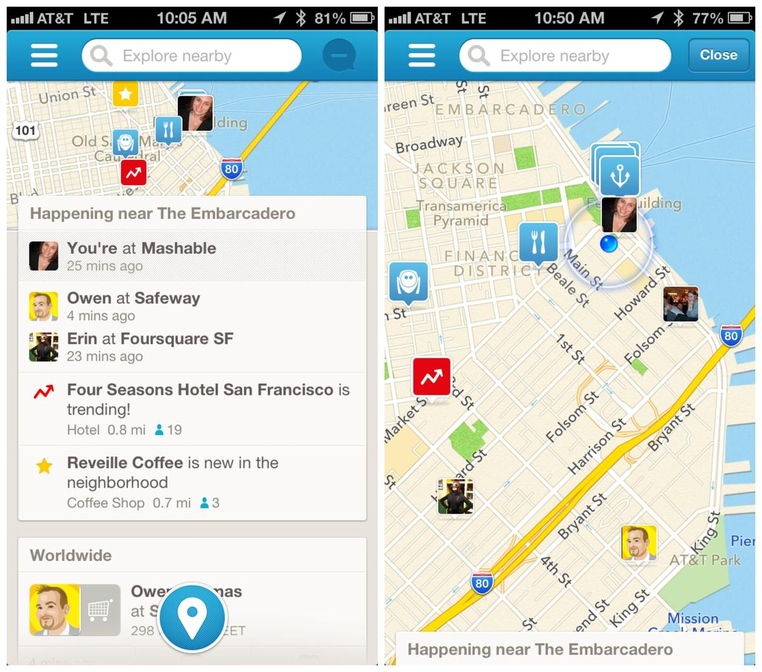
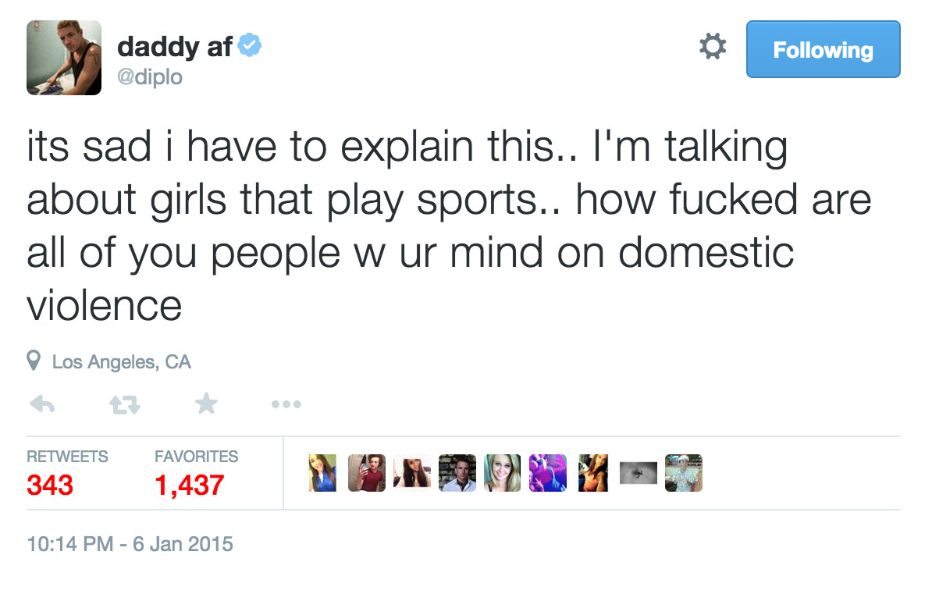
Social Media Data are Multi-Dimensional in Nature
category
location
time
text
popularity
Notes:
This page shows a twitter message and a foursquare check in. ’Various information are presented here, such as ..
While these dimensions are explicitly given,

Slide 6
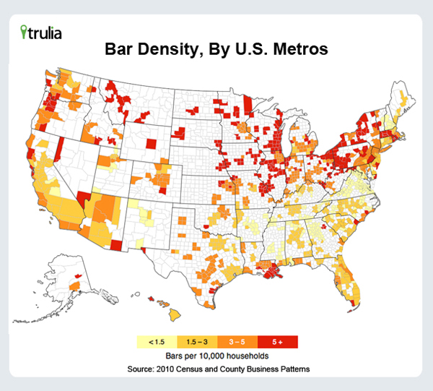
Some Important Dimensions are Hidden and Need to be Inferred
Geographic Clusters
Notes:
Other dimensions can be hidden or not directly observed, yet they are important for specific applications
For e.g., this figure shows how bars are grouped into clusters. These geo clusters do not follow any administrative borderlines or any well-defined partitions.
But they are valuable information for understanding users’ preference at different regions and may help recommending bars to users.

Slide 7
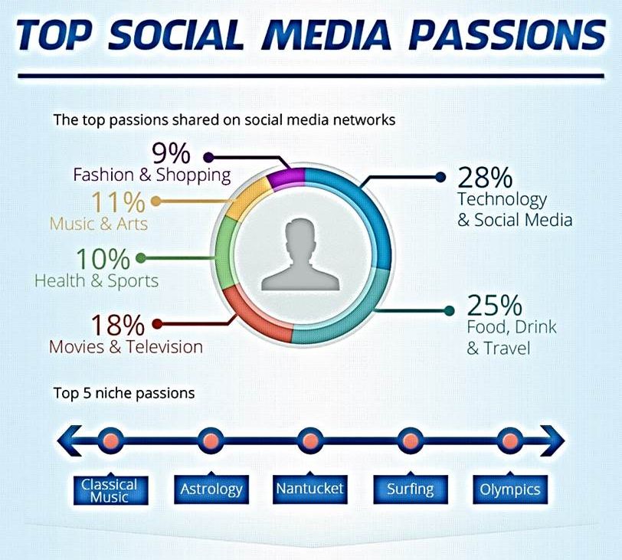
Some Important Dimensions are Hidden and Need to be Inferred
Topics
Source: http://www.adweek.com/socialtimes/top-social-media-passions-infographic/187616
Notes:
what social media users are passionate about
Again, these dimensions are important for understanding users’ preference and yet not explicitly given.

Slide 8
Challenges in Social Media Data Mining
Data Quality
Useful information buried in huge amount of irrelevant information (noisy data)
Lack of annotation
Notes:
The second challenge that motivates this study is data quality.
Due to the sheer volume of data generated by social media, it is often difficult to fully understand what is being said about various topics. To make things worse, annotation of this massive data is also extremely time-consuming and hard to get.

Slide 9


Besides the Heterogeneous Data Dimensions, Social Media is A Noisy Place
Notes:
In a survey conducted by five9, they found that consumers want social customer care and companies realize it’s critical to support customers via social. Yet 60% of companies are not formally supporting social customer care. Why? Picking out the messages that really need attention to out of the huge amount of social noise is very challenging.

Slide 10
Challenges in Social Media Data Mining
Data Complexity
Heterogeneous data dimensions
Some are explicitly given; others need to be inferred
Need effective learning methods to model multiple dimensions in a principled manner
Data Quality
Useful information buried in huge amount of irrelevant information (noisy data)
Lack of annotation
Need effective learning methods that can identify the desired knowledge out of social noise
Notes:
These challenges motivate my study. The complexity of data is calling for effective ….
The unreliable quality of data is callling for methods that can effectively identify the desired knowledge out of social noise.
----- Meeting Notes (5/6/16 11:05) -----
interestingness social noise dataless fact influence customized
related work
minimax entropy model related work
nlp tool
contribution
structure
refer back to the previous section topic model
user study
discriminitive generative
user event recommendation
title more specific
more application for customized
additional information from tweet users
social impact comparison

Slide 11

How can we model heterogeneous data dimensions in a principled way?
How can we find desired information and discover interesting knowledge out of social noise?
Notes:
The goal of this thesis is to answer the following 2 questions:
First,

Slide 12
Roadmap
A Principled Minimax Entropy Method to Model Multi-Dimensional User Preference in Social Media
Jingjing Wang, Min Li, Jiawei Han, Xiaolong Wang, "Modeling Check-in Preferences with Multidimensional Knowledge: A Minimax Entropy Approach", (WSDM'16)
Leverage External Sources for Multi-Dimensional Knowledge Discovery in Social Media
Jingjing Wang, Wenzhu Tong, Hongkun Yu, Min Li, Xiuli Ma, Haoyan Cai, Tim Hanratty, and Jiawei Han, "Mining Multi-Aspect Reflection of News Events in Twitter: Discovery, Linking and Presentation", (ICDM'15)
Min Li*, Jingjing Wang*, Wenzhu Tong, Hongkun Yu, Xiuli Ma, Yucheng Chen, Haoyan Cai, Jiawei Han, "EKNOT: Event Knowledge from News and Opinions in Twitter", (AAAI'16) (system demo)
Leverage Social Media for Customized Event Profiling in Traditional News Media
Jingjing Wang, Huan Gui, Meng Jiang, Quan Yuan, Keyang Zhang, and Jiawei Han, "Leverage Social Media for Customized Event Profiling", (Under review for CoNLL’16)
Notes:
Here is a roadmap of this presentation I have presented the 1st 2 work in Prelim brief
The first contribution of this dissertation is a Principled Method for Modeling Multi-Dimensional user preference
And In particular, we consider the check-in preference in social media platforms

Slide 13
What Affects A User’s Check-in Behavior?
A toy example
On a Friday evening, Alice just finished yet another week of hard work; she would like to have a great dinner at a seafood restaurant and then she figures a popular Boiling Crab branch is just nearby. Then it is likely that she would check in at this place
Notes:
Before we start, let’s think about what affects a user’s check-in behavior?
Goal: Given a training set of user check-in histories, jointly learn the conditional probability of checking in at POI l given a user u and time t, denoted by π_{utl} = p(l|u,t); and the geographic clustering structure governed by latent parameters o and r.

Slide 14
User Preference in Social Media
Typical formulation in the literature
Multiple dimensions combined in an ad-hoc way
w_{time}f_{time} (x,y,Θ_{time}) + w_{category}f_{category}(x,y,Θ_{category})
+ w_{geographic} f_{geographic}(x,y,Θ_{geographic}) + …
Predict => A preference distribution over targets (location)
Issues
The weights w are specified by human as hyper-parameters to trade off different dimensions
A separate model for each dimensions; Parameters Θ are learned independently
Periodicity Model
Topic Model
Gaussian Mixture Model
Notes:
Now if we want to model these different dimensions, a typical formulation looks like this
They have a model for temporal preference, which might be a periodicity model, …
x,y,theta?

Slide 15
User Preference in Social Media
Typical formulation in the literature
Multiple dimensions combined in an ad-hoc way
w_{time}f_{time} (x,y,Θ_{time}) + w_{category}f_{category}(x,y,Θ_{category})
+ w_{geographic} f_{geographic}(x,y,Θ_{geographic}) + …
Predict => A preference distribution over targets (location)
Issues
The weights w are specified by human as hyper-parameters to trade off different dimensions
A separate model for each dimension; Parameters Θ are learned independently
Periodicity Model
Topic Model
Gaussian Mixture Model
Notes:
Now if we want to model these different dimensions, a typical formulation looks like this

Slide 16
User Preference in Social Media
Minimax Entropy Model
Multiple dimensions combined in a principled way
w_{time}f_{time} (x,y,Θ_{time}) + w_{category}f_{category}(x,y,Θ_{category})
+ w_{geographic} f_{geographic}(x,y,Θ_{geographic}) + …
Predict => A preference distribution over targets (location)
Jointly learn the weights w and the parameters Θ
Periodicity Model
Topic Model
Gaussian Mixture Model
Latent features governed by arbitrary parametric forms
Notes:
In my work, we aim to model different dimensions in a principled way
Instead of learning independent models, we propose to jointly learn the weights and the parameters.
We consider these f’s as latent features and fit them in a maximum entropy framework.

Slide 17
How to find the optimal Θ jointly with w?
Theorem
The optimal Θ should be chosen such that the maximized conditional entropy H*(y|x, Θ) is minimized:
Θ* = arg min_{Θ}H*(y|x, Θ)
Notes:
We prove the following theorem which tells us how to find the optimal theta jointly with w

Slide 18
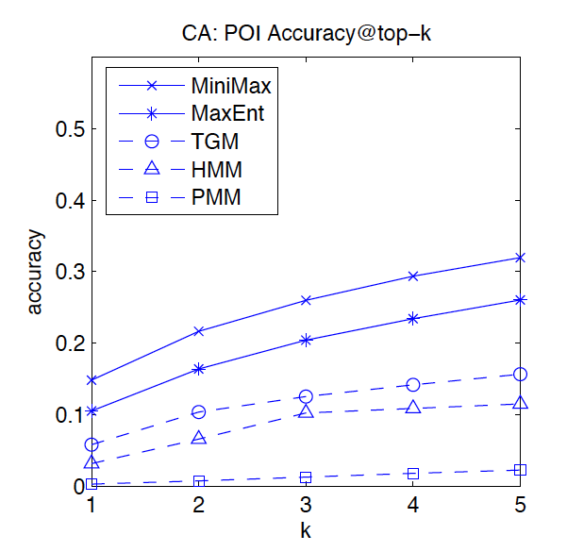
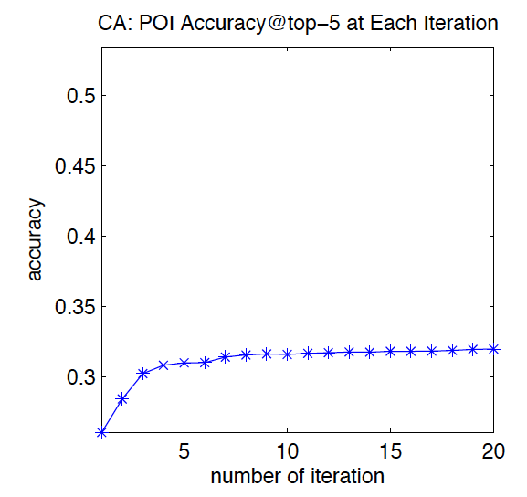
Location prediction/recommendation on Foursquare check-in data
CA 483,813 check-in records, 4,163 users in California USA, December 2009 - June 2013
World 2,290,996 check-in records, 11,326 users around the world, January 2011 to December 2011
Accuracy of Prediction
Benefit from latent features
Notes:
We did exp on 4sq data and use a location prediction task to evaluation our model.
We observe significant improvement of the accuracy of prediction, which is shown in the left figure
We also investigate the benefit of joint learning the latent features. As shown in the right figure, the improvement is obvious.
#####A simple model systematically combining multiple dimensions work better than existing models where only a subset of dimensions are considered in an ad-hoc manner.

Slide 19
Summary of Contributions
Model heterogeneous data dimensions in a principled way
A simple model systematically modeling multiple dimensions work better than existing complex models where different dimensions are considered in an ad-hoc manner
Cheng et al. (2013), Cho et al. (2011), Yuan et al. (2013)
A general guidance to model ambiguous features in complex social media data
Notes:
We propose a minimax ent model which handles heteo …
We demonstrate that a simple
Our model also provide a general guidance
###
Our approach has the advantage of investigating explicit user and location features, as well as jointly learning the latent geographic clustering
Our model strikes a good balance between explaining seen data and generalizing to unseen data by requiring the model to satisfy meaningful relaxed constraints
And when more types of data are available, our model is able to incorporate them as well.

Slide 20
Minimax entropy in the literature
Zhu et al., (1997) Feature selection in computer vision
Zhou et al., (2012) Infer missing binary features
My model:
[Boosted Expressiveness] Generalize the latent features to arbitrary parametric forms f(x,y,Θ)
Directly corresponds to the generative assumptions of the features
Especially suited to the multi-dimensional user preference modeling in social media platforms
[Elegant optimization algorithm] Alternating maximization
Notes:
Comparing with other models that also explores the minimax entropy principle, our model significantly boosts the expressiveness.
…, where these heterogeneous data dimensions need to be modeled under various assumptions
We also come up with an elegant opti alg. By alternating maximization.
####
Maximum entropy principle
First proposed by E.T. Jaynes in 1957
A very general rationale why we should select the model with the maximum entropy
Widescale applications
Introducing latent variables to discriminative models is not new
The minimax entropy principle was first proposed in the computer vision community by Zhu et al. for feature selection within the MaxEnt framework
Previous work have introduced hidden variables to other discriminative models such as SVMs and CRFs in various forms as well
Allowing features to be governed by a parametric form is innovative
Directly corresponds to the generative assumptions of the features
Especially suited to the situations where multidimensional heterogeneous information need to be modeled

Slide 21
Model Expressiveness
Joint learning of weights and features
Skip-Gram Word2Vec model
Word vectors {Θ₁ , Θ₂,…}
Context vectors {w₁ ,w₂,…}
Vocabulary size: V
Corresponding minimax entropy model:
Feature vector for (word x, context y) pair:
f(x,y,Θ) = [0, …,0, Θ_{x}, 0,…, 0]
Global weight vector: w = [w₁ ,w₂,…]
y-1
V-y
Notes:
Going beyond the preference modeling problem, I put an further example here to demonstrate the expressiveness of our model.
In a broad sense, our model jointly learns the weights and the feature representations

Slide 22
Roadmap
A Principled Minimax Entropy Method to Model Multi-Dimensional User Preference in Social Media
Jingjing Wang, Min Li, Jiawei Han, Xiaolong Wang, "Modeling Check-in Preferences with Multidimensional Knowledge: A Minimax Entropy Approach", (WSDM'16)
Leverage External Sources for Multi-Dimensional Knowledge Discovery in Social Media
Jingjing Wang, Wenzhu Tong, Hongkun Yu, Min Li, Xiuli Ma, Haoyan Cai, Tim Hanratty, and Jiawei Han, "Mining Multi-Aspect Reflection of News Events in Twitter: Discovery, Linking and Presentation", (ICDM'15)
Min Li*, Jingjing Wang*, Wenzhu Tong, Hongkun Yu, Xiuli Ma, Yucheng Chen, Haoyan Cai, Jiawei Han, "EKNOT: Event Knowledge from News and Opinions in Twitter", (AAAI'16) (system demo)
Leverage Social Media for Customized Event Profiling in Traditional News Media
Jingjing Wang, Huan Gui, Meng Jiang, Quan Yuan, Keyang Zhang, and Jiawei Han, "Leverage Social Media for Customized Event Profiling", (Under review for CoNLL’16)
Notes:
That concludes my discussion on the minimax ent model.
Now let’s go to the 2nd part.

Slide 23

Leverage External Sources for Multi-Dimensional Knowledge Discovery in Social Media
Unstructured, fragmented and noisy social media posts
Lack of available annotation
News as supervision (Formally written; Comprehensive facts)
Event discovery in social media
A novel angle
Notes:
As we mentioned before, event detection and summarization in social media can benefit lots of applications
However, social media data is unstructured…Usually we do not have available annotations.
In order to still extract useful knowledge, we propose to approach this problem from a novel angle

Slide 24
Mining Reflection of News Events in Twitter
An influential event (Sony Entertainment Hack) took place…
A news article with the following headline
A tweet on the same event
We identify facts from news to guide the discovery of discussions/opinions from Twitter
Output a comprehensive view of events from both sources
What are the major events?
Who are the key players in each event
How people talk about each event
When is the event and how long does the event last?
Notes:
This exmple shows that we can identify ..
And finally ,we would like to output

Slide 25
Joint study of news and tweets in the literature
Zhao et al. (2011); Subavsic et al. (2011) Comparative data analysis assuming documents corresponding to an event is given
Guo et al. (2013); Tsagkias et al. (2011) Linking an individual news article/tweet to the other source
Extensive annotation and training
Notes:
In reality, this is often not the case, because getting the relevant news articles and tweets for a particular event is non trivial. These kind of datasets are either handcrafted by human or retrieved by carefully designed queries.
Comparative data analysis of word usage, sentiment polarity and topic categories in an aggregate sense

Slide 26
My work
A unified framework for event level knowledge discovery
Extendable Multi-dimensional Topic Model Jointly Modeling Text, Time, Entities (person, location, organization) to automatically extract accurate event descriptors as supervision
Dataless Bootstrapping Link tweets to news articles in a completely unsupervised manner
Notes:
In my work, we develop
First we develop a
And then we employ

Slide 27
Extendable Multi-dimensional Topic Model
Shared topic distribution for different dimensions (words/entities/time)
Generate Words
φ^{w}
φ^{w}_{B}
K
Generate Entities
θ
z^{w}
w
s^{w}
N^{w}
Generate time
z^{t}
s^{t}
λ_{B}
μ_{B}
t
z^{e}
e
s^{e}
N^{e}
σ_{B}
E
D
μ
σ
φ^{e}_{B}
K
K
φ^{e}
K
E
E
Notes:
Here is our extendable …..
It jointly considers words, entities and time to generate coherent topics, which are used as event descriptors.

Slide 28
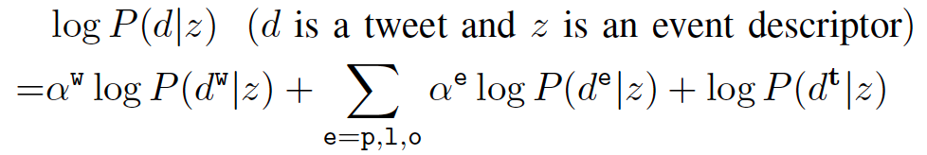
Use the Learned Topic Model to Guide Knowledge Discovery in Twitter
Challenges
Vocabulary gap between news and tweets
Noisy tweets irrelevant to news
Dataless Bootstrapping
Seed tweets
Bootstrap a required amount of tweets for each event
words
entities
time
Weighs the semantic representation extracted from news in a way that best fits the specific tweet collection
Arbitraty multi-class classifier taking arbitrary features
Notes:
And then we use the learned topic model to guide ….
We handle the challenges of vocabulary gap and noise by bootstrapping, where the seed tweets are retrieved by a multidimensional language model.
###
Bootstrapping weighs the semantic representation extracted from news in a way that best fits the specific tweet collection, which naturally close the vocabulary gap
The classifier used in bootstrapping can be any multi-class classifier taking arbitrary features
Now we have the event/aspect distributions as accurate descriptors, we want to use these descriptors to guide event discovery in twitter
Query Likelihood Language Model
Rank documents (tweets) by the probability of being generated by the query

Slide 29
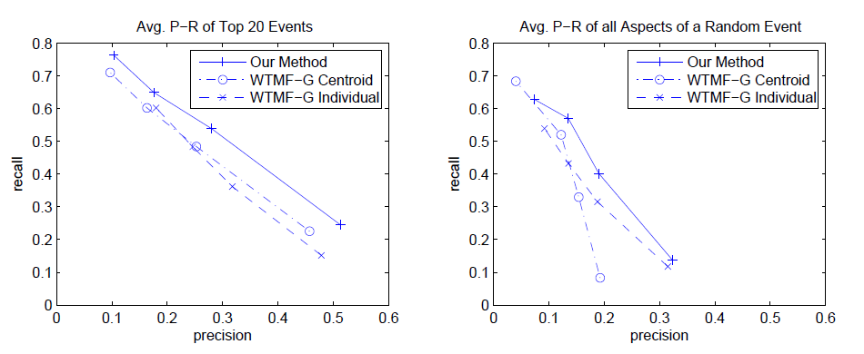
Precision-Recall of the Linking Algorithm
Accurate multi-dimenisonal event descriptors
Proper handling of the vocabulary gap
Notes:
why

Slide 30
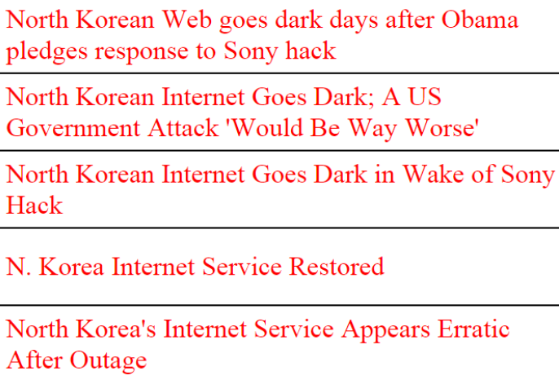
A Sample of News Articles…
Full results:
https://dl.dropboxusercontent.com/u/155956218/Event_description_overall.html
Notes:
After we link these two sources, for each event, we can get a bunch of relevant news articles and a bunch of relevant tweets.
Here is a sample of the news articles we get for the North Korean Internet Outage event

Slide 31
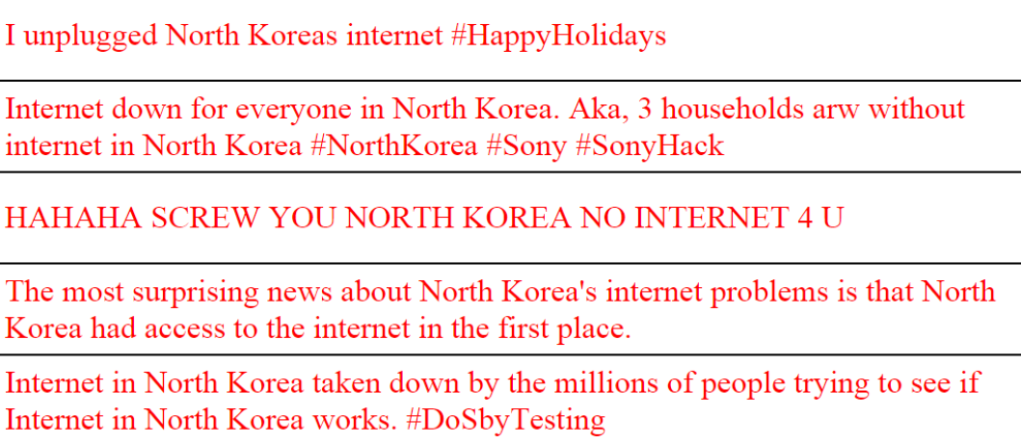
A Sample of Tweets…

Slide 32
Summary of Contributions
A unified framework to guide event discovery in Twitter
[Extendable Multi-dimensional Topic Model] Jointly Modeling Text, Time, Entities (person, location, organization) to automatically extract events as supervision
[Dataless Bootstrapping] Link tweets to news articles in a completely unsupervised manner
Select informative tweets under overwhelming noise
Bridge the vocabulary gap between news and tweets
[A valuable dataset]
News articles and tweets grouped by events
Notes:
Last but not least, this study provides us a valuable dataset, where news…..by events. This dataset can be used for subsequent tasks such as event summarization and opinion mining.
###
News articles and tweets grouped by events. Useful for various applications such as opinion mining/comparison, multi-corpus text summarization and information diffusion.

Slide 33
Roadmap
A Principled Minimax Entropy Method to Model Multi-Dimensional User Preference in Social Media
Jingjing Wang, Min Li, Jiawei Han, Xiaolong Wang, "Modeling Check-in Preferences with Multidimensional Knowledge: A Minimax Entropy Approach", (WSDM'16)
Leverage External Sources for Multi-Dimensional Knowledge Discovery in Social Media
Jingjing Wang, Wenzhu Tong, Hongkun Yu, Min Li, Xiuli Ma, Haoyan Cai, Tim Hanratty, and Jiawei Han, "Mining Multi-Aspect Reflection of News Events in Twitter: Discovery, Linking and Presentation", (ICDM'15)
Min Li*, Jingjing Wang*, Wenzhu Tong, Hongkun Yu, Xiuli Ma, Yucheng Chen, Haoyan Cai, Jiawei Han, "EKNOT: Event Knowledge from News and Opinions in Twitter", (AAAI'16) (system demo)
Leverage Social Media for Customized Event Profiling in Traditional News Media
Jingjing Wang, Huan Gui, Meng Jiang, Quan Yuan, Keyang Zhang, and Jiawei Han, "Leverage Social Media for Customized Event Profiling", (Under review for CoNLL’16)
Notes:
In the last part of my thesis, I explore a novel problem of customized event summarization taking advantage of the linked dataset from the second part.

Slide 34
Given the same major events or breaking news, why did Mr. Jon Stewart attract a significantly larger audience than an ordinary CNN anchor, and become irreplaceable for “The Daily Show”?
Besides blending humor with the news, the show catches important and interesting facts from the large set of news articles
Notes:
To motivate this study, let’s consider a question here
`
, In contrast, the general ‘narrative facts provided by regular television news may distract the listeners from the stories in politics

Slide 35
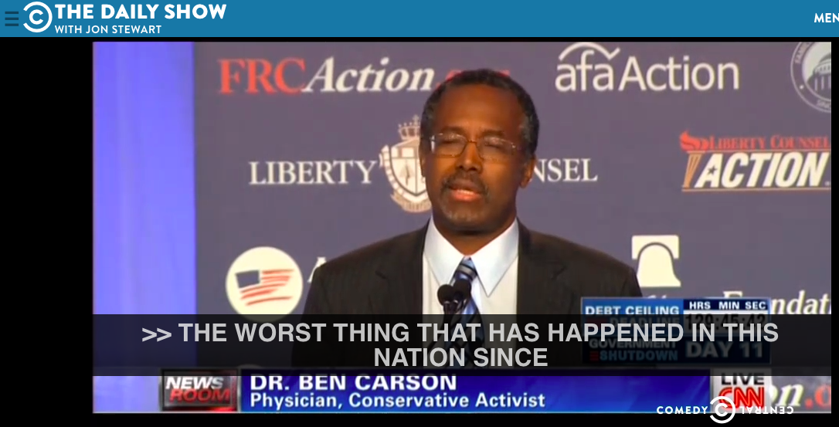
Talking about Obamacare…
Notes:
…picked up the words from the republican celerities who opposed obamacare

Slide 36
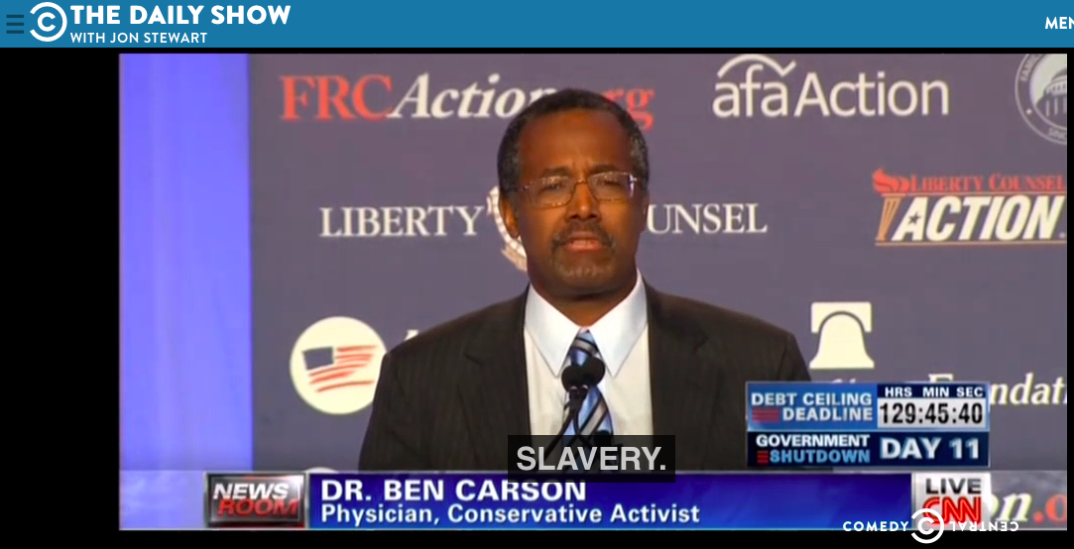

Slide 37
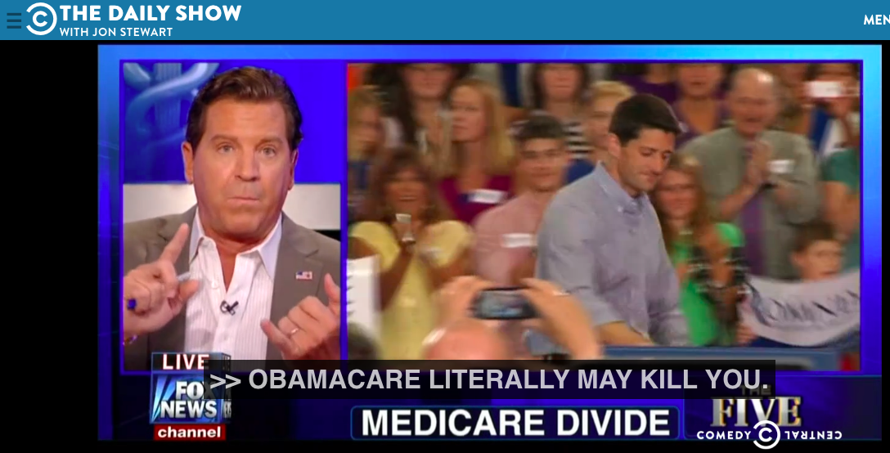
Notes:
Eric Bolling
These facts might be much more interesting to the users than the the narrative facts such as how many people have enrolled in obamacare, or the coverage of different groups.

Slide 38
Customized News Event Profiling
Rank news sentences in a listener-centric way with both relevance and interestingness
Notes:
In this work, we consider the problem of

Slide 39
A Novel Angle
Incorporating interestingness into the news data is nontrivial
It is impossible to collect the reflection from the crowd before the event profile comes out
The first work leveraging social media information to infuse plain texts with listeners’ interests
Notes:
To the best of our knowledge, this is the first work to infuse listeners’ interests from social media into news summaries

Slide 40
Challenges
Fine grained connection between news sentences and tweets is harder to get
Little overlapping part between the news proxies and users’ Twitter accounts
Vocabulary gap: formal language style of news vs. versatile tweets
Manual annotation is infeasible
Notes:
While this direction sounds promising, we face many challenges here.
Unlike the event-level linking, now the unit we consider is news sentences, fine grained connection…
the massive tweets as related or unrelated with given news documents is not
So the question becomes how do we build bridges to connect news and tweets?

Slide 41
Key Insight: Use Content Units
Key concepts that are natural and meaningful semantic units appearing in news articles and tweets
News sentences
Hillary Clinton spoke at an event in New York City to celebrate a new law that will gradually raise the state’s minimum wage
News Sentences
Content units
tweets
tweets
Hillary Clinton
Democratic presidential candidate Bernie Sanders' campaign is accusing rival Hillary Clinton of not being "sincere" in her public support for New York's move to raise the minimum wage to $15 an hour
Shut Up! Shut Up! Shut Up, Already! The Minimum Wage Does NOT Kill Jobs!
gun control
income tax
Excellent from @Noahpinion Don't trust anyone who says (re eg migration or minimum wage) "it's just supply & demand"
minimum wage
Notes:
Although different vocabularies may be used for news and tweets, especially descriptive words such as adjectives and adverbs, content units are less versatile and very indicative of the content. Like here minimum wage can be a good content unit.
Therefore we use content units as bridges to enable fine-grained information transfer between news sentences and tweets.

Slide 42
Using Content Units as Bridges
News sentences and tweets are naturally connected via content units
Extracting content units
Wikipedia concepts
Broad coverage, high quality, timeliness
Demonstrated robustness as semantic representations of text in the literature (Gabrilovich and Markovitch, 2007; Maio et al., 2015)
Key concepts that are natural and meaningful semantic units appearing in news articles and tweets. They are good content indicators
Notes:
In our implementation, we choose to use wikipedia concepts as our content units.
####
Laki (Liu et al. 2016), SegPhrase (Liu et al. 2015), Clustype (Ren et al. 2014) and various information extraction tools

Slide 43
Event Profile
Co-Rank news sentences and tweets
News sentences {n} with scores {s(n)}
Tweets {t} with scores {s(t)}
Desired properties:
Reflect the social impact
News scores are affected by how interesting they are, measured by tweets
Respect relevance
Consistence with the global context of the event
Coherence between news sentences and tweets
Notes:
Now we have news sentences and tweets bridged by content units, the problem becomes how to determine the link strength and propagate the social impact from tweets to news sentences based on this graph.
our goal is to co-rank news sentences and tweets and we have the following desired properties:
Top ranked news sentences and tweets should reflect the social impact
The ranking scores of news sentences are affected by how interesting they are, measured by tweets
We should also respect relevance
Top ranked news sentences and tweets in the profile should be consistent with the global context of the event
Top ranked news sentences and tweets should be coherent with each other

Slide 44
Graph Construction
Content unit: represent by its context
Edge weights
Similarity between the semantic representation of a content unit and a news sentence / a tweet
Impose Social Impact
The edge weights going out of a tweet is boosted by a multiplier of the popularity of this tweet
Notes:
To this end, we construct the graph as follows;
With respect to each source, the local context of a content unit are aggregated to generate a semantic representation
The edge weight in the graph is determined by the similarity between the semantic representation of a content unit and a news sentence / a tweet
Impose Social Impact
The edge weights going out of a tweet is boosted by a multiplier of the popularity of a tweet

Slide 45
Global Context
φ^{w}
φ^{w}
K
θ
z^{w}
w
s^{w}
N^{w}
z^{t}
s^{t}
λ_{B}
z^{e}
e
s^{e}
μ_{B}
t
N^{e}
E
σ_{B}
D
μ
σ
K
K
φ^{c}
φ^{c}
K
Notes:
Collapse different types of entities into one distribution of content units

Slide 46
Global Context
φ^{w}
φ^{w}
K
θ
z^{w}
w
s^{w}
N^{w}
z^{t}
s^{t}
Collapse different types of entities into one distribution of content units
λ_{B}
z^{c}
c
s^{c}
μ_{B}
t
N^{c}
σ_{B}
D
μ
σ
K
K
φ^{c}
φ^{c}
K
Notes:
The per-topic word distribution is used as a global context for each event

Slide 47
Propagation Path
News
Sentences
Content units
tweets
Notes:
We specify the propagation path as in the upper figure. We can see that via content units, the influence first transfers from news to tweets and then back to news.

Slide 48
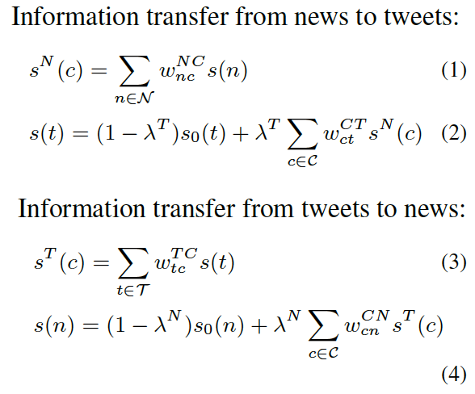
The Propagation Model on the Tripartite Graph: Combining Global and Local Context
Local Context
Global Context

Slide 49
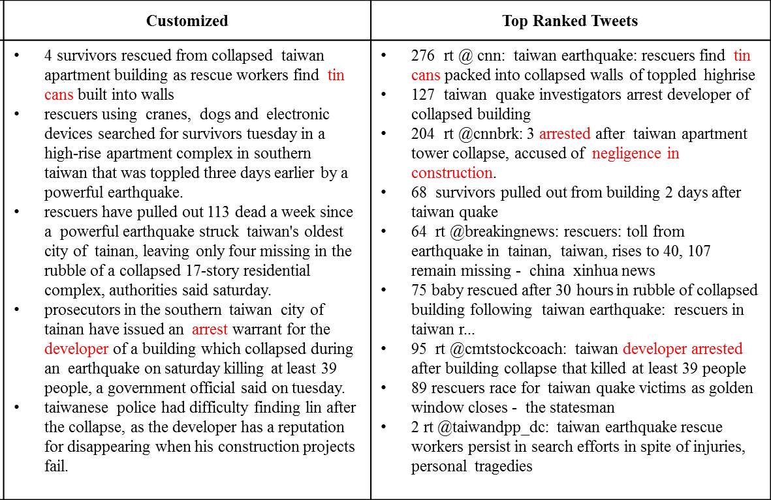
An End-to-End Framework
Event Detection
Global distributions from the topic model
Local context of content units
Global Context
Local Context
News Sentences
Content units
tweets
Profiling

Slide 50
Experimental Design
Challenges
Impossibility of building a fair gold-standard
Distinctiveness from existing work
Wei et al. (2014,2015), Yulianti et al. (2015)
Recovering a gold standard news summary unaware of tweets
A customized event summary may deviate from the news gold standard but better accommodate users' interest
Notes:
Evaluating customized event proles is a hard task. The main diculty in evaluation comes
from the impossibility of building a fair gold-standard against which the results can be
compared. It is very hard to determine what a correct customized prole is and standard
Rouge measures used in traditional summarization tasks are hardly applicable due to the
subjective nature of our problem.
The existing work all target at recovering a gold standard summary generated solely from news source, trying to justify that additional information from Twitter can improve the performance on news summarization. In sharp contrast,

Slide 51
Experimental Design
Compare the customized event profile against an event profile generated solely from news articles (LexRank)
Hypothesis
LexRank summary represents an unbiased ranking of the news sentences
Capture the drift from the “canonical” news summary by involving tweets
We investigate the drift of content units, words, and sentences

Slide 52
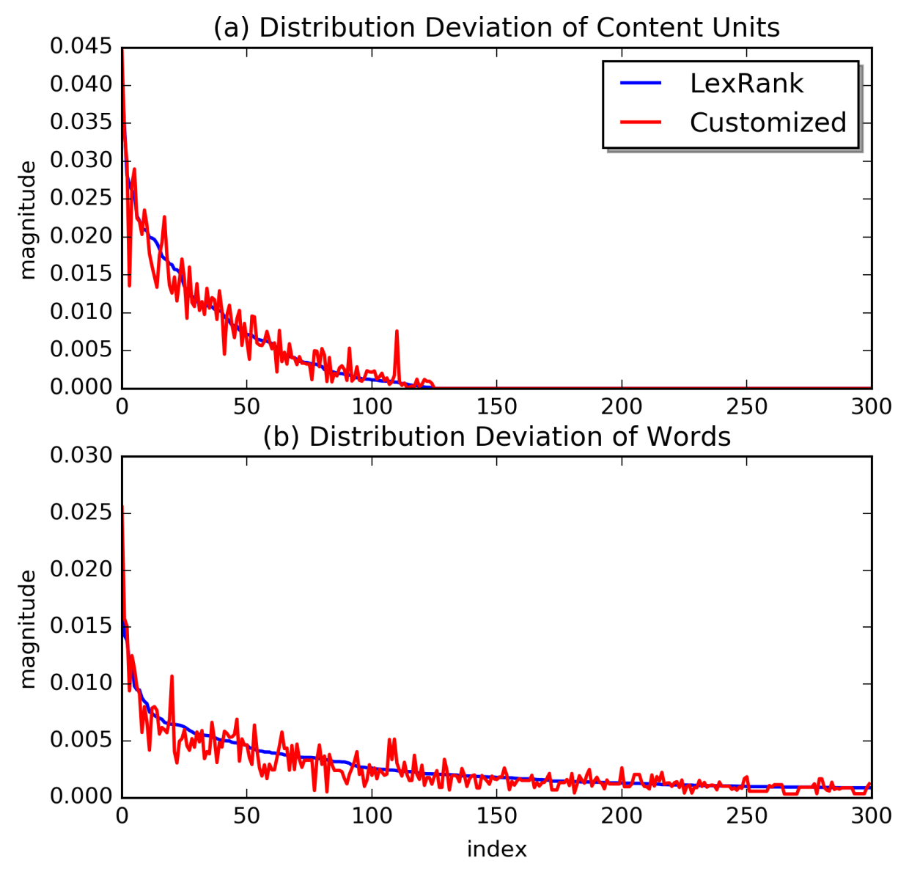
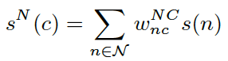
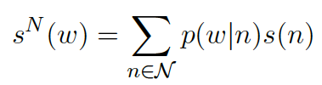
Experimental Results - 2016 Taiwan Earthquake
Deviation of
content units
and words
Notes:
The earthquake was the deadliest earthquake in Taiwan since 1999. Almost all of the deaths were caused by a collapsed
apartment building.
We plotting the two distributions with the horizontal axis being ordered according to LexRank scores. We can see the distribution from the customized profile gives spikes to certain content units/words
-----
This event is manually identied from the output of the graphical
model and the relevant news articles and tweets are collected to generate the event prole.
There is a total of 282 news sentences and 8466 tweets in this event.

Slide 53
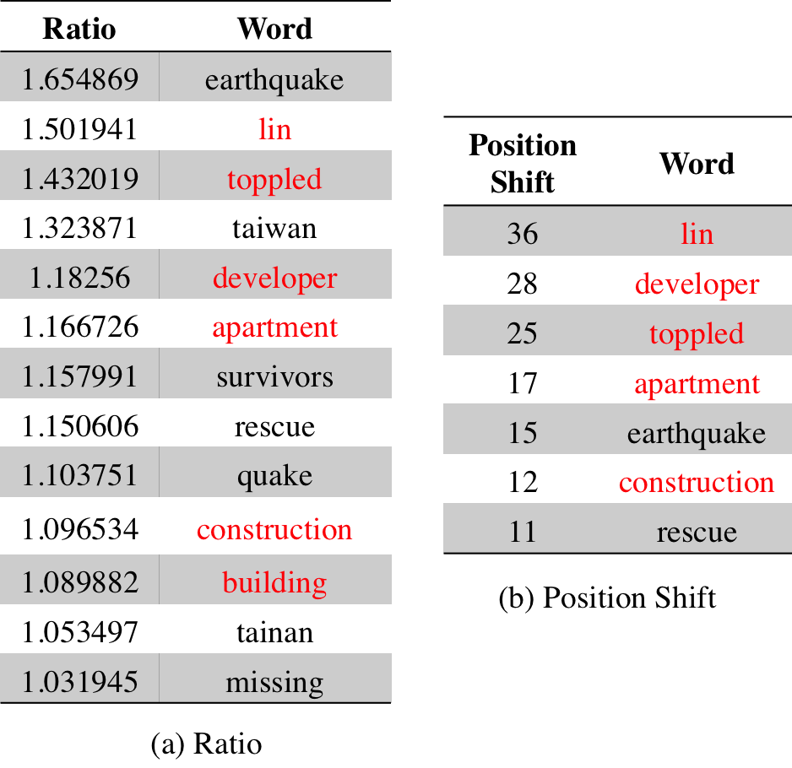
Word Deviation
Notes:
The word “lin” is the family name of the chairman in the developer company that built the collapsed building.

Slide 54
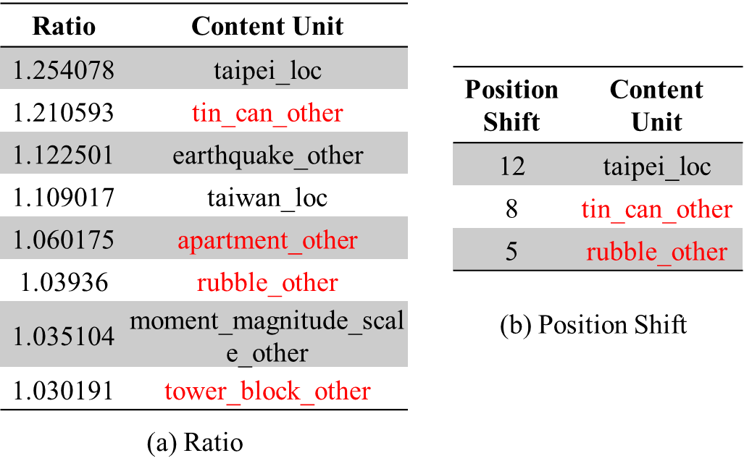
Content Unit Deviation
Notes:
The content units and words may not seem to make a lot of sense now but they will become clear as we investigate the drift of sentences.

Slide 55
Profiles
LexRank | Customized | Top Ranked Tweets
saturday's quake killed at least 38 people in tainan city in southern taiwan, all but two of them in the collapse of the 17-story building. more than 100 people are believed to be still buried in the collapsed building from a disaster that struck during the most important family holiday in the chinese calendar -- the lunar new year holiday. earthquakes frequently rattle taiwan, but most are minor and cause little or no damage, though a magnitude-7.6 quake in central taiwan in 1999 killed more than 2,300 people. survivors pulled out from building 2 days after taiwan quake rescuers said tsao was found under the body of her husband, who had shielded her from a collapsed beam, taiwan's government-run central news agency reported. | 4 survivors rescued from collapsed taiwan apartment building as rescue workers find tin cans built into walls rescuers using cranes, dogs and electronic devices searched for survivors tuesday in a high-rise apartment complex in southern taiwan that was toppled three days earlier by a powerful earthquake. rescuers have pulled out 113 dead a week since a powerful earthquake struck taiwan's oldest city of tainan, leaving only four missing in the rubble of a collapsed 17-story residential complex, authorities said saturday. prosecutors in the southern taiwan city of tainan have issued an arrest warrant for the developer of a building which collapsed during an earthquake on saturday killing at least 39 people, a government official said on tuesday. taiwanese police had difficulty finding lin after the collapse, as the developer has a reputation for disappearing when his construction projects fail. | 276 rt @ cnn: taiwan earthquake: rescuers find tin cans packed into collapsed walls of toppled highrise 127 taiwan quake investigators arrest developer of collapsed building 204 rt @cnnbrk: 3 arrested after taiwan apartment tower collapse, accused of negligence in construction. 68 survivors pulled out from building 2 days after taiwan quake 64 rt @breakingnews: rescuers: toll from earthquake in tainan, taiwan, rises to 40, 107 remain missing - china xinhua news 75 baby rescued after 30 hours in rubble of collapsed building following taiwan earthquake: rescuers in taiwan r... 95 rt @cmtstockcoach: taiwan developer arrested after building collapse that killed at least 39 people 89 rescuers race for taiwan quake victims as golden window closes - the statesman 2 rt @taiwandpp_dc: taiwan earthquake rescue workers persist in search efforts in spite of injuries, personal tragedies
Notes:
We use the top ranked sentences and tweets as the summaries.
------
The summary from LexRank focused on the objective facts of the earthquake, where it reports causalities [ˈkæʒuəlti], rescue efforts, and presents facts of historical earthquakes. However, if we look at the top ranked tweets, while the rescue efforts did attract much attention, people paid even more attention to the collapsed apartment building. Tin cans built into the walls of the toppled complex raised people’s concern. The arrest of the developers of the collapsed building also got substantially tweeted.

Slide 56
LexRank
saturday's quake killed at least 38 people in tainan city in southern taiwan, all but two of them in the collapse of the 17-story building.
more than 100 people are believed to be still buried in the collapsed building from a disaster that struck during the most important family holiday in the chinese calendar -- the lunar new year holiday.
earthquakes frequently rattle taiwan, but most are minor and cause little or no damage, though a magnitude-7.6 quake in central taiwan in 1999 killed more than 2,300 people.
survivors pulled out from building 2 days after taiwan quake
rescuers said tsao was found under the body of her husband, who had shielded her from a collapsed beam, taiwan's government-run central news agency reported.
Notes:
The summary from LexRank focused on the objective facts of the earthquake, where it reports causalities [ˈkæʒuəlti], rescue efforts, and presents facts of historical earthquakes.

Slide 57
Tweets
276 rt @ cnn: taiwan earthquake: rescuers find tin cans packed into collapsed walls of toppled highrise
127 taiwan quake investigators arrest developer of collapsed building
204 rt @cnnbrk: 3 arrested after taiwan apartment tower collapse, accused of negligence in construction.
68 survivors pulled out from building 2 days after taiwan quake
64 rt @breakingnews: rescuers: toll from earthquake in tainan, taiwan, rises to 40, 107 remain missing - china xinhua news
75 baby rescued after 30 hours in rubble of collapsed building following taiwan earthquake: rescuers in taiwan r...
95 rt @cmtstockcoach: taiwan developer arrested after building collapse that killed at least 39 people
89 rescuers race for taiwan quake victims as golden window closes - the statesman
2 rt @taiwandpp_dc: taiwan earthquake rescue workers persist in search efforts in spite of injuries, personal tragedies
Notes:
However, if we look at the top ranked tweets, while the rescue efforts did attract much attention, people paid even more attention to the collapsed apartment building. Tin cans built into the walls of the toppled complex raised people’s concern. The arrest of the developers of the collapsed building also got substantially tweeted.

Slide 58
Customized
4 survivors rescued from collapsed taiwan apartment building as rescue workers find tin cans built into walls
rescuers using cranes, dogs and electronic devices searched for survivors tuesday in a high-rise apartment complex in southern taiwan that was toppled three days earlier by a powerful earthquake.
rescuers have pulled out 113 dead a week since a powerful earthquake struck taiwan's oldest city of tainan, leaving only four missing in the rubble of a collapsed 17-story residential complex, authorities said saturday.
prosecutors in the southern taiwan city of tainan have issued an arrest warrant for the developer of a building which collapsed during an earthquake on saturday killing at least 39 people, a government official said on tuesday.
taiwanese police had difficulty finding lin after the collapse, as the developer has a reputation for disappearing when his construction projects fail.
Notes:
Now let’s look at the customized summary. Asides from the key causality facts and rescue efforts, discussions on the cause of the collapsed building, the arrest of the building developers are also presented, which correctly reflect the social impact.

Slide 59
User Study
A user was given 4 summaries for each event
(a) Tweets summary based on popularity
(b) News summary from LexRank
(c) News summary from our customized event profile
(d) Tweet summary from our customized event profile
Notes:
In order to obtain a more accurate measure of the summary quality, we also performed a comprehensive user study

Slide 60
Users Were Presented with Four Questions
Overall quality
Is each of the four summaries a good summary by itself in terms of informativeness and coherence?
Tweet coherence
Is the tweet summary by popularity reasonably covered in the tweet summary generated from the customized event profile?
Interest drift
Does the tweet summary from the customized profile contains noticeable interest drift from the LexRank summary?
Interestingness: if yes, is the customized news summary capable of reflecting the drift of interest?

Slide 61
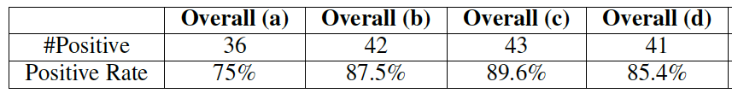
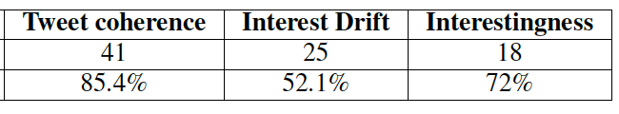
Results from User Study
Key Findings
Interest drift is observed in about half of the events
For 72% of the time when interest drift exists, our customized summary is able to reflect the drift
Restrict to a cleaner set with positive answers for overall quality for all four summaries, this percentage increased to 86.7%
Notes:
All summaries are generally considered as good summaries
Our tweet summary is able to capture the most popular tweets
The tweet summary by popularity are less robust than others
Interest drift is observed in about half of the events, which indicates that half of the news articles can get a potentially more interesting summary
For 72% of the time when interest drift exists, our customized summary is able to reflect the drift. If we consider a cleaner set of events with positive answers for overall quality for all four summaries, this percentage increased to 86.7%.

Slide 62
Summary
A novel angle: the first work leveraging social media information to infuse plain texts with listeners’ interests
Key insight: use content units to bridge news and tweets at a fine-grained level
A tripartite graph propagation model seamlessly combining global and local context
A comprehensive user study

Slide 63
Recap
A Principled Minimax Entropy Method to Model Multi-Dimensional User Preference in Social Media
Jingjing Wang, Min Li, Jiawei Han, Xiaolong Wang, "Modeling Check-in Preferences with Multidimensional Knowledge: A Minimax Entropy Approach", (WSDM'16)
Leverage External Sources for Multi-Dimensional Knowledge Discovery in Social Media
Jingjing Wang, Wenzhu Tong, Hongkun Yu, Min Li, Xiuli Ma, Haoyan Cai, Tim Hanratty, and Jiawei Han, "Mining Multi-Aspect Reflection of News Events in Twitter: Discovery, Linking and Presentation", (ICDM'15)
Min Li*, Jingjing Wang*, Wenzhu Tong, Hongkun Yu, Xiuli Ma, Yucheng Chen, Haoyan Cai, Jiawei Han, "EKNOT: Event Knowledge from News and Opinions in Twitter", (AAAI'16) (system demo)
Leverage Social Media for Customized Event Profiling in Traditional News Media
Jingjing Wang, Huan Gui, Meng Jiang, Quan Yuan, Keyang Zhang, and Jiawei Han, "Leverage Social Media for Customized Event Profiling", (Under review for CoNLL’16)

Slide 64
Summary of this Presentation
Graph-based Propagation
Model on a
Tripartite Graph
Technical Models
Minimax entropy Model
Topic model, language model, bootstrapping
Dimensions
Locations, time, category, popularity
Entities (person/location/organization), time, text
Content units,
time, text
explicit
Membership in geographic clusters
Topic Membership
Topic Membership
implicit
Sources
Foursquare
News, Twitter
News, Twitter
Applications
Location prediction/recommendation
Event-Based linking between News and Tweets
Customized
Event profiling
[WSDM’16]
[ICDM’15]
[AAAI’16]
[under review
By CoNLL’16]

Slide 65
Summary of this Presentation
Graph-based
Propagation Model on
a Tripartite Graph
Technical Models
Minimax entropy Model
Topic model, language model, bootstrapping
Locations, time, category, popularity
Entities (person/location/organization), time, text
Dimensions
explicit
Content units,
time, text
Membership in geographic clusters
Topic Membership
Topic Membership
implicit
Sources
Foursquare
News, Twitter
News, Twitter
Location prediction/recommendation
Event-Based linking between News and Tweets
Customized
Event profiling
Applications

Slide 66
Future Directions -- Personalized Applications
Personalized News Recommendation
Fine grained entity linking and typing
Aspect/Schema identification in events
Incorporating Network information
User Preference from
Social Media
Linked Event/Topic Discovery and Summarization in News and Social Media

Slide 67
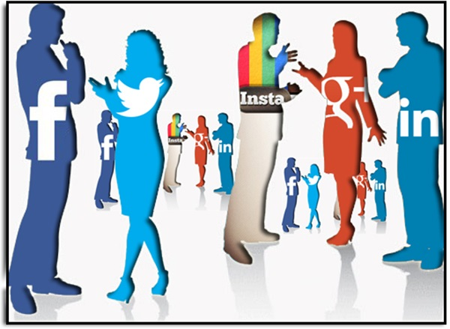
Future Directions – Integrating Multi-Genre Social Media Data
Notes:
----- Meeting Notes (5/6/16 11:21) -----
user interest in social media dimensions
interest/preference
crowd/

Slide 68
Overview of My Other Research
User Preference in Web Search
Jingjing Wang, Changsung Kang, Yi Chang and Jiawei Han, "Learning Hostname Preference to Enhance Search Relevance", in Proc. of 2016 Int. Joint Conf. on Artificial Intelligence (IJCAI'16), New York City, NY, July 2016
Jingjing Wang, Changsung Kang, Yi Chang and Jiawei Han, "A Hierarchical Dirichlet Model for Taxonomy Expansion for Search Engines", Proc. of 2014 Int. World-Wide Web Conf. (WWW'14), Seoul, Korea, April 2014.
Pattern Discovery and Prediction
Xiuli Ma, Guangyu Zhou, Jingjing Wang, Jian Peng, and Jiawei Han, "Complexes Detection in Biological Networks via Diversified Dense Subgraphs Mining", in Proc. of 2016 Int. Conf. on Research in Computational Molecular Biology (RECOMB'16), Los Angeles, CA, Apr. 2016
Jingjing Wang, Hongbo Deng, and Jiawei Han, "Topic Periodicity Discovery from Text Data", in Proc. SPIE Vol. 9499, Next-Generation Analyst III, Baltimore, Maryland, April 2015
Zhenhui Li, Jingjing Wang, and Jiawei Han, "ePeriodicity: Mining Event Periodicity from Incomplete Observations", IEEE Transactions on Knowledge and Data Engineering (TKDE), 27(5): 1219-1232 (2015)
Bhaskar Prabhala, Jingjing Wang, Budhaditya Deb, Tom La Porta, Jiawei Han, "Leveraging periodicity in human mobility for next place prediction", IEEE Wireless Communications and Networking Conference (WCNC'14), Istanbul, Turkey, Apr. 2014.
Mudhakar Srivatsa, Raghu Ganti, and Jingjing Wang, "Map Matching: Facts and Myths" (poster), 21st ACM SIGSPATIAL Int. Conf. on Advances in Geographic Information Systems (ACM SIGSPATIAL GIS 2013), Orlando, Florida, USA, Nov. 2013.
Zhenhui Li, Jingjing Wang, and Jiawei Han, "Mining Periodicity for Sparse and Incomplete Event Data", Proc. of 2012 ACM SIGKDD Int. Conf. on Knowledge Discovery and Data Mining (KDD'12), Beijing, China, Aug. 2012.
Jingjing Wang and Bhaskar Prabhala, "Periodicity Based Next Place Prediction", Proc. of Workshop on Mobile Data Challenge by Nokia (in conjunction with Pervasive 2012), Newcastle, UK, June 2012.

Slide 69
Acknowledgement
Thanks to my dissertation committee
Prof. Jiawei Han, Prof. ChengXiang Zhai, Prof. Julia Hockenmaier, Prof. Qiaozhu Mei (UMich)
Thanks to my research collaborators and everyone who constantly cheers me up
Prof. Zhenhui Li, Bhaskar Prabhala, Penn State University
Dr. Changsung Kang, Dr. Hongbo Deng, Dr. Yi Chang, Yahoo! Labs
Dr. Tim Hanratty, Army Research Lab
Mudhakar Srivatsa, Raghu Ganti, IBM T.J. Watson Research Center
Prof. Xiuli Ma, Peking University
Xiaolong Wang, Min Li, Wenzhu Tong, Dr. Meng Jiang, Dr. Quan Yuan, Huan Gui, Hongkun Yu, Guangyu Zhou, Haoyan Cai, Yucheng Chen, and everyone in DAIS
Special thanks to Jump Labs

